Slide 1
DATA INTERPRETATION

Slide 2
Table : Production of Major Minerals and Metals (Million Tonnes)

Slide 3

Which mineral/metal witnessed highest growth rate in production from 2005 to 2011? A. Iron Ore B. Aluminium C. Gold D. Copper
The growth rate in production from 2005 to 2011
Iron ore = $\frac{163−100}{100} ∗100=63\%$
Aluminium = $\frac{36}{69} ∗100=52\%$ (approx)
Gold= $\frac{10}{15} ∗100=66.66\%$
Copper = $\frac{32}{71} ∗100=45\% (approx)$
Answer: Gold

Slide 4
Which year has witnessed highest absolute increase in total production of minerals and metals? A. 2006 B. 2008 C. 2011 D. None of the above
Solution:
The year wise total production of minerals & Metals:
2005 = 69+91+71+15+100 = 346 2006= 75+88+75+18+120=376 2007=81+97+79+21+102=380 2008= 98+107+88+25+131=449
2009= 93+110+92+24+143=462 2010= 99+116+97+20+154 = 462
2011= 105+122+103+125+103=518
Year to year increase
2006= 376-346=30 2007= 380-376=4 2008= 449-380=69 2009=462-449=13
2010= 486-462= 24 2011 = 518-486=32
Thus 2008 witnessed the highest increase.

Slide 5

Highest annual growth rate in production is recorded in A. Iron Ore in 2008 B. Gold in 2011 C. Aluminium in 2008 D. Gold in 2006
Solution:
Iron ore in 2008 = $\frac{131−102}{102} ∗100=28.43\%$
Gold in 2011 = $\frac{25−20}{20} ∗100=25\%$
Aluminium in 2008 = $\frac{98−81}{81} ∗100=21\%$
Gold in 2006 = $\frac{18−15}{15} ∗100=20\%$ Answer: Iron ore in 2008

Slide 6
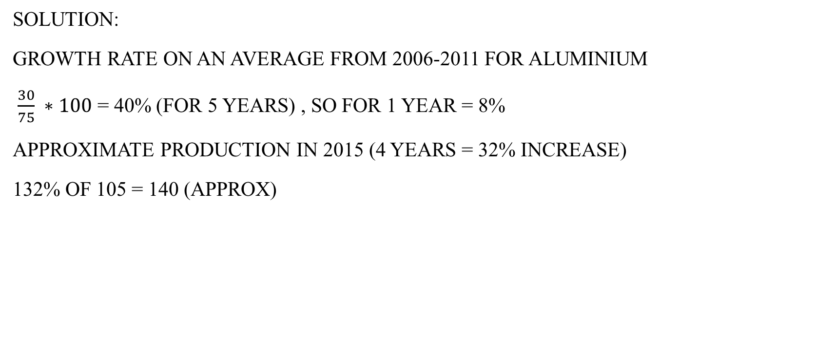
If annual average growth rate in production exhibited during 2006 to 2011 continues for next 4 years, then what will be the approximate production of aluminium in the year 2015? A. 125 million tonnes B. 140 million tonnes C. 155 million tonnes D. 160 million
Solution:
Growth rate on an average from 2006-2011 for aluminium
$\frac{30}{75} ∗100$ = 40% (for 5 years) , So for 1 year = 8%
Approximate production in 2015 (4 years = 32% increase)
132% of 105 = 140 (approx)

Slide 7
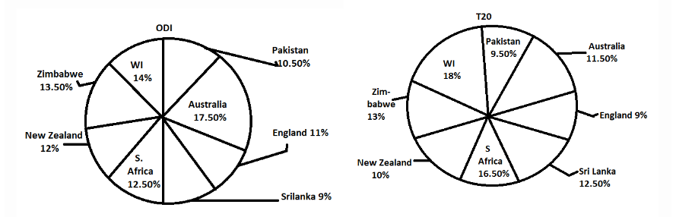
The following pie-charts show the run scored by a batsman against different countries in one-day internationals (ODI) and Twenty (T20) world cup matches. Runs scored by the batsman in ODI and T20 are 2800 and 2000 respectively.

Slide 8
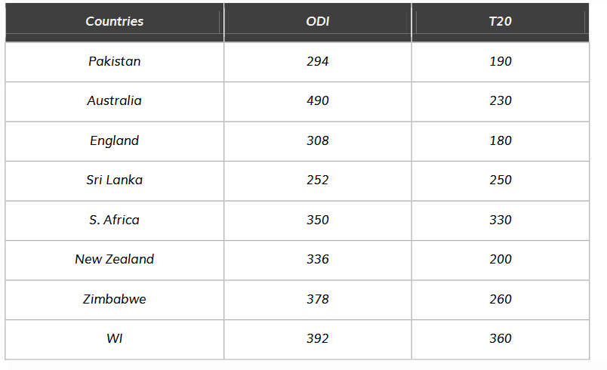

If the batsman played 14 innings against Sri lanka in ODI and remained not out in 5 innings. Find his average runs scored against Sri lanka. A. 28 B. 24 C. 26 D. 22 E. None of the above
Solution:
Required Percentage = $\frac{252}{14−5}$
= $\frac{252}{9}$ = 28

Slide 9

Runs scored by the batsman against New Zealand in T20 matchesare approximately what percent of the runs scored against Pakistan in ODI? A. 64% B. 66% C. 62% D. 68% E. None of the above
Solution:
Required Percentage = $\frac{200}{294}$ * 100 = 68%

Slide 10
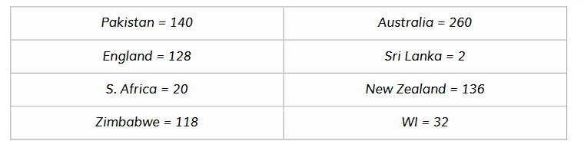
In case of which of the following countries, the difference between the runs scored in ODI and T20 is the second lowest? A. Srilanka B. Pakistan C. South Africa D. West Indies E. None of the above
Solution:
The difference between the runs scored in ODI and T20 against:
Second lowest : South Africa

Slide 11

The runs scored by the batsman against WI in T20 is approximatelywhat percent of the runs scored against Australia in ODI? A. 71% B. 75% C. 73% D. 69% E. None of the above
Solution:
Required Percentage = $\frac{360}{490}$ * 100 = 73%

Slide 12

If the batsman had scored 280 runs against Pakistan in T20 matches, What would have been its percentage in the T20 match, if the total runs scored in T20 remains the same? A. 12% B. 16% C. 14% D. 10% E. None of the above
Solution:
Required Percentage = $\frac{280}{2000}$ * 100 = 14%

